Slide 1

Astrea.
A.K.A Shooting Stars

Slide 2
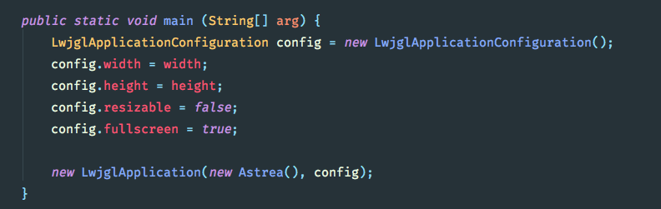
DesktopLauncher

Slide 3
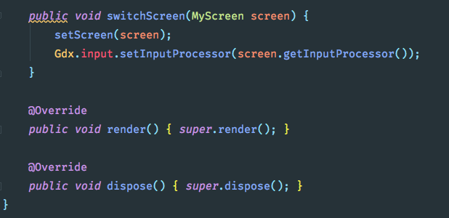
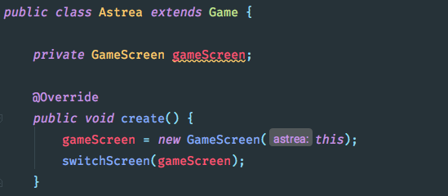
DesktopLauncher

Slide 4
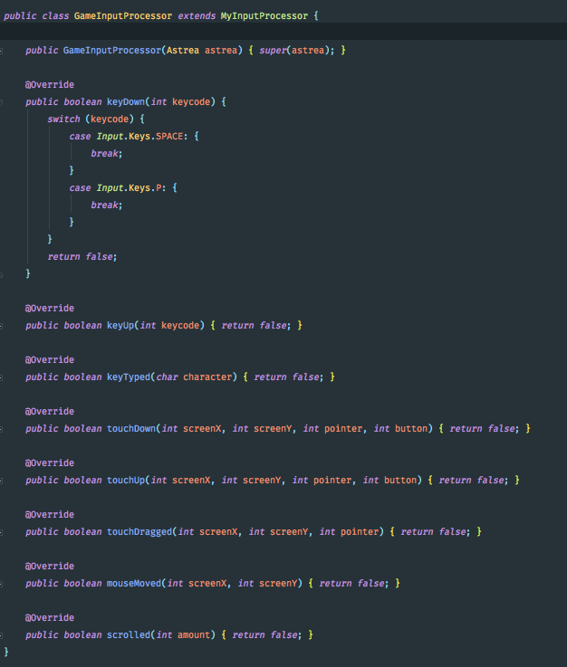
Astrea

Slide 5
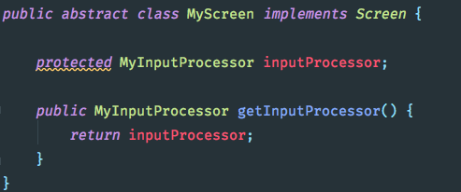
MyScreen
Literally just an abstract class that adds the input processor to every screen that we use. It implements LibGDX Screen Class.
MyInputProcessor
The input processor isn’t currently used, however if we decide to implement a menu screen it would pass input events to the screen.

Slide 6
MyInputProcessor
The input processor isn’t currently used, however if we decide to implement a menu screen it would pass input events to the screen.
MyScreen
Literally just an abstract class that adds the input processor to every screen that we use. It implements LibGDX Screen Class.

Slide 7
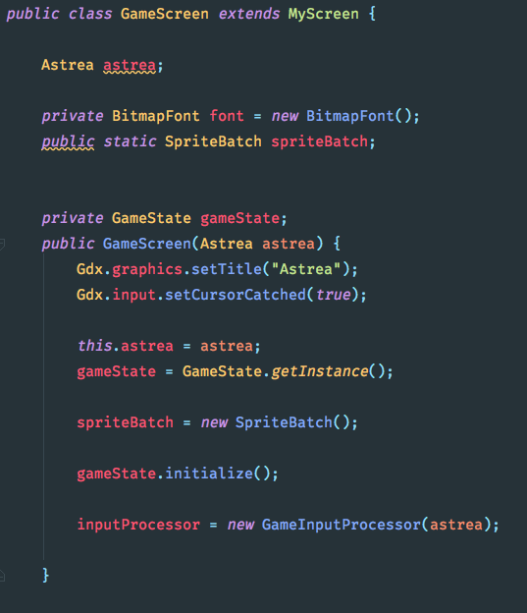
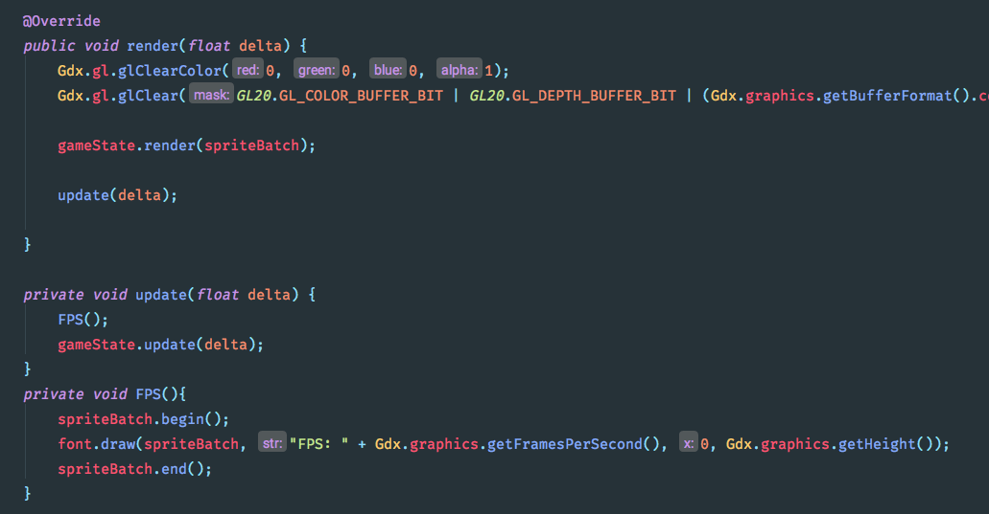
MyInputProcessor
The input processor isn’t currently used, however if we decide to implement a menu screen it would pass input events to the screen.
GameScreen
The game screen takes the update(), render() etc callbacks and passing them to the GameState. More on that in a second.
Gdx.input.setCursorCached() hides the cursor.
It is also responsible for displaying the FPS.
The methods below just call the .render() and .update() methods on the GameState (see next slide) and renders the FPS before anything else.

Slide 8
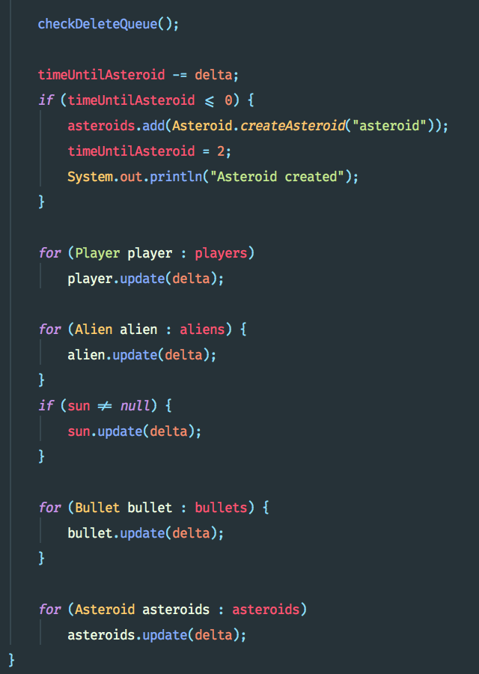
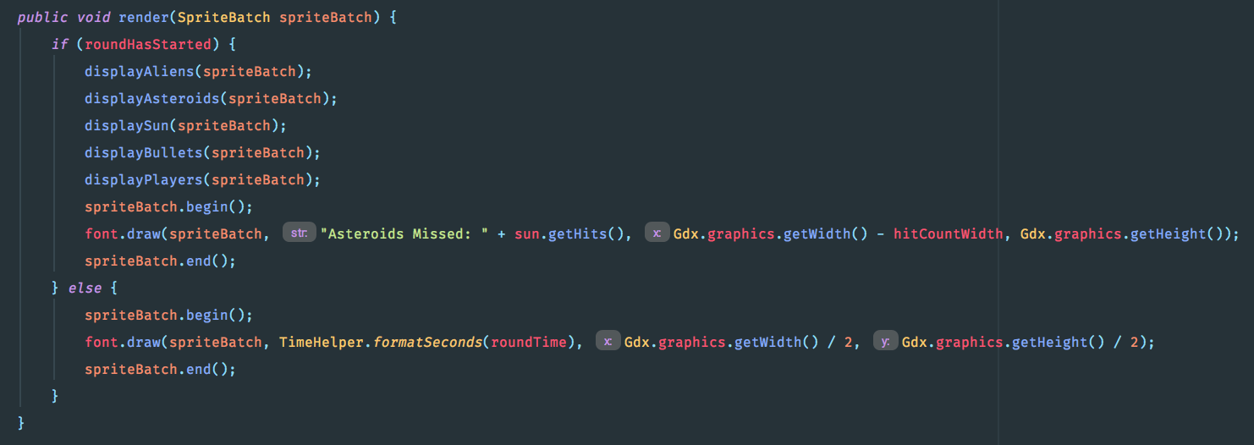
MyInputProcessor
The input processor isn’t currently used, however if we decide to implement a menu screen it would pass input events to the screen.
GameScreen
The methods below just call the .render() and .update() methods on the GameState (see next slide) and renders the FPS before anything else.
The game screen takes the update(), render() etc callbacks and passing them to the GameState.
It is also responsible for displaying the FPS.

Slide 9
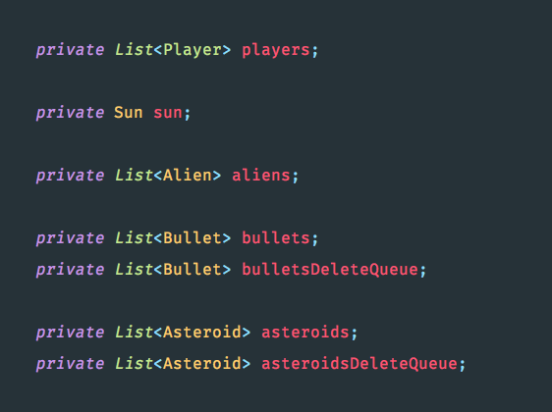
GameScreen
MyInputProcessor
The input processor isn’t currently used, however if we decide to implement a menu screen it would pass input events to the screen.
The methods below just call the .render() and .update() methods on the GameState (see next slide) and renders the FPS before anything else.
GameState
GameState keeps track of everything on the screen. It is responsible for rendering all the entities and calling the update methods. It keeps track of the round time and displays a countdown timer. The player calls shootBullet to create the bullets.
Update Method
Render Method
The game screen takes the update(), render() etc callbacks and passing them to the GameState.
It is also responsible for displaying the FPS.

Slide 10
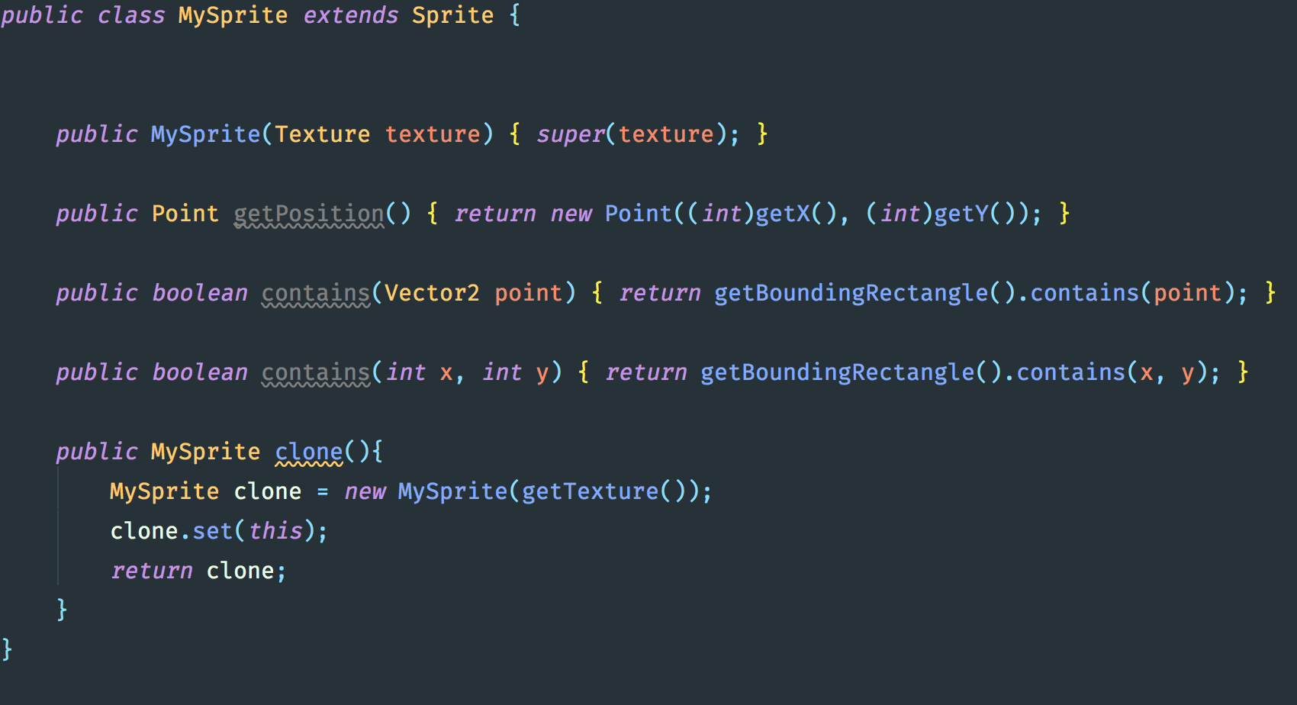
The input processor isn’t currently used, however if we decide to implement a menu screen it would pass input events to the screen.
GameState
The variables on the left contain every single object that is to be rendered on screen.
Render Method
The game screen takes the update(), render() etc callbacks and passing them to the GameState.
It is also responsible for displaying the FPS.
Update Method

Slide 11
The input processor isn’t currently used, however if we decide to implement a menu screen it would pass input events to the screen.
MySprite & Entities
Every entity on screen is a subclass of Entity. The Entity class has a variable of type MySprite which holds positions and helper methods
Render Method
Update Method

Slide 12
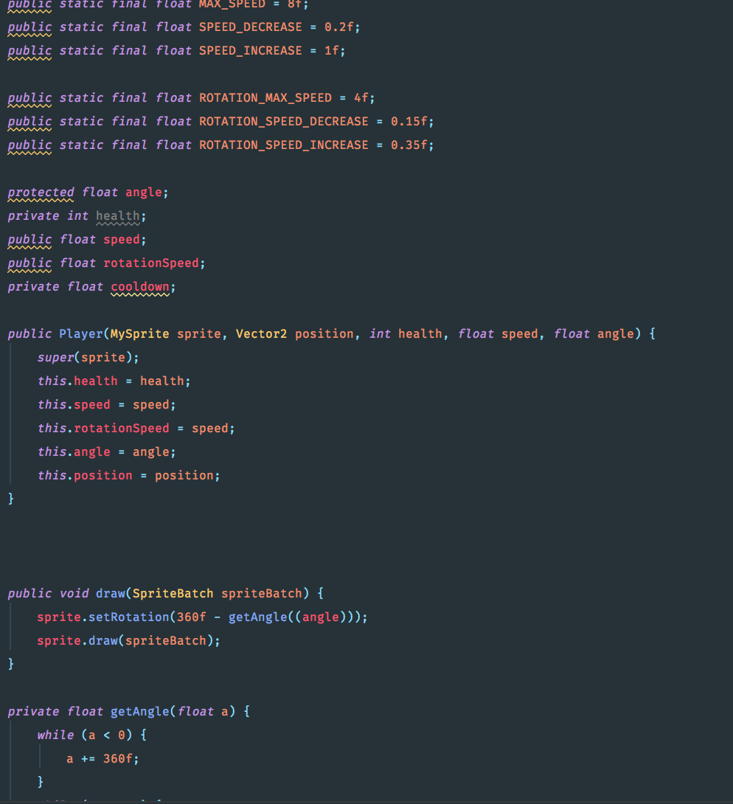
The input processor isn’t currently used, however if we decide to implement a menu screen it would pass input events to the screen.
MySprite & Entities
Every entity on screen is a subclass of Entity. The Entity class has a variable of type MySprite which holds positions and helper methods
Render Method
Update Method

Slide 13
The input processor isn’t currently used, however if we decide to implement a menu screen it would pass input events to the screen.
MySprite & Entities
Every entity on screen is a subclass of Entity. The Entity class has a variable of type MySprite which holds positions and helper methods
Render Method
Update Method

Slide 14
The input processor isn’t currently used, however if we decide to implement a menu screen it would pass input events to the screen.
MySprite & Entities
Every entity on screen is a subclass of Entity. The Entity class has a variable of type MySprite which holds positions and helper methods
Render Method
Update Method

